Slide 1
Image Classification using Deep Learning
Kayla Neal for Pearce Lab

Slide 2
Imports
import tensorflow as tf
from tensorflow.keras.models import Sequential
from tensorflow.keras.layers import Conv2D, Activation, MaxPooling2D, Dense, Flatten, Dropout, InputLayer
from tensorflow.keras.preprocessing.image import ImageDataGenerator
import numpy as np
from IPython.display import display
from PIL import Image
Using TensorFlow and Keras to build, train, test, and evaluate model.

Slide 3
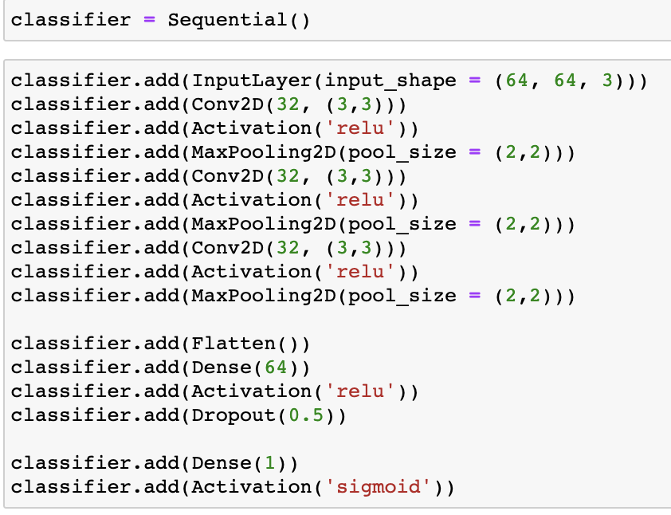
Building a Classifier
MaxPooling downsamples the input along the designated dimensions
Conv2D is a convolutional layer that creates a tensor of outputs
The classifier is built under the Sequential() model system of tf.keras. The important criteria regarding this decision is the linear stack a Sequential model uses to build and connect layers.
tf.keras.layers api describes the different layers in detail with what to use each for and what the arguments are.
Dropout only applies to training!

Slide 4
Using ImageDataGenerator to Create Datasets
# Step 1: initialize generators
trainGen = ImageDataGenerator( rescale = 1./255, shear_range = 0.2, zoom_range = 0.2, horizontal_flip = True )
testGen = ImageDataGenerator( rescale = 1./255 )
# Step 2: create datasets
trainSet = trainGen.flow_from_directory( dir_name, target_size = (64,64), batch_size = 32, class_mode = ‘binary’ )
testSet = testGen.flow_from_directory( dir_name, target_szie = (64,64), batch_size = 32, class_mode = ‘binary’ )
The ImageDataGenerator from keras is a quick, easy, and efficient way to create datasets.
To prevent overfitting, the training generator has augmentation parameters included to diversify the set. This isn’t necessary for the test generator.
This classifier is being used to distinguish between two types categories -> class mode is binary

Slide 5
Compile and Fit Model
compile the model:
classifier.compile( optimizer = ‘rmsprop’, loss = ‘binary_crossentropy’, metrics = [‘accuracy’] )
when distinguishing between 2 classes, binary crossentropy is the preferred loss function
for multiple: categorical crossentropy
there are many different keras optimizers - the most commonly used is Adam, here we used rmsprop.
train the model:
classifier.fit( trainSet, steps_per_epoch = 625, epochs = 30, validation_data = testSet, validation_steps = 5000 )
to save the model, use mode_namel.save( ‘model_name.h5’ )

